Slide 1
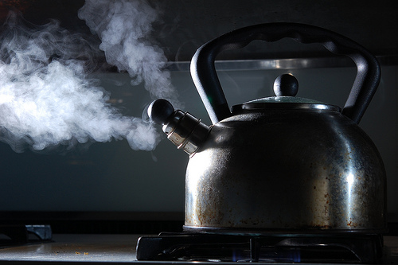
Heat Capacity
This lesson will introduce you to specific heat capacity, the heat needed to increase the temperature of an object
You will also learn how to use the specific heat capacity and the LCE to solve heat exchange problems

Slide 2
Learning Goals
By the end of this lesson, you will be able to:
define specific heat capacity
explain heat exchange
solve problems involving heat capacity
solve problems involving heat exchange

Slide 3
Success Criteria
Can I:
state and explain specific heat capacity
state and explain the factors that affect specific heat capacity
calculate the amount of heat transferred to an object
understand and explain the principle of heat exchange
solve heat exchange problems

Slide 4
Specific Heat Capacity
The transfer of heat to any substance depends on
three factors:
1. the mass of the substance
2. the type of substance
3. the temperature difference
Specific heat capacity, c, is the amount of thermal energy needed to raise the temperature of 1 kg of a substance by 1ºC

Slide 5
specific heat capacity is measured in J/kgºC
table 1 on page 281 has the specific heat capacities of some common substances
the amount of thermal energy, Q, needed to change the temperature of a substance is given by:
where Q is the thermal energy transferred in J, m is the
mass in kg, c is the specific heat capacity in J/kgºC, and
DT is the change in temperature.
Note: ΔT = T_{f} – T_{i}

Slide 6
Sample Problem
How much heat energy is required to heat a 2.5 kg piece of Cu pipe from 25.0ºC to 66.0ºC?
Sol’n:
m = 2.5 kg
ΔT = T₂ – T₁
= 41 K
c = 3.9x10² J/kg K
∴ the thermal energy required is 4.0 x 10⁴ J

Slide 7
Heat Exchange
When two objects at different temperatures are mixed, the heat lost by the hotter object must equal the heat gained by the cooler object. This is the LCE
This is just the law of conservation of energy

Slide 8
Sample Problem
A .50 kg pot of hot water for tea has cooled to 40.0ºC. How much water at 100.0ºC must be added to raise the temperature of the water to 65.0ºC?
Sol’n:
Givens:
cool water
m_{c} = .50 kg
c_{w} = 4.19x10³ J/kg K
T₁ = 313 K
T₂ = 338 K
ΔT = 25.0 K
hot water
m_{h} = ?
c_{w} = 4.19x10³ J/kg K
T₁ = 373K
T₂ = 338 K
ΔT = -35.0 K
According to the principle of heat exchange:

Slide 9
∴ the mass of hot water is .36 kg

Slide 10
HOMEWORK
Read Section 6.3
Review Tutorial 1 – 2 pg 282 – 284
Questions 1 – 3 pg 283
1 – 2 pg 286
1 – 6 pg 287

